Slide 1
Agile Communication
Project

Slide 2
Agile Communication
Project
Sprints 1-3

Slide 3
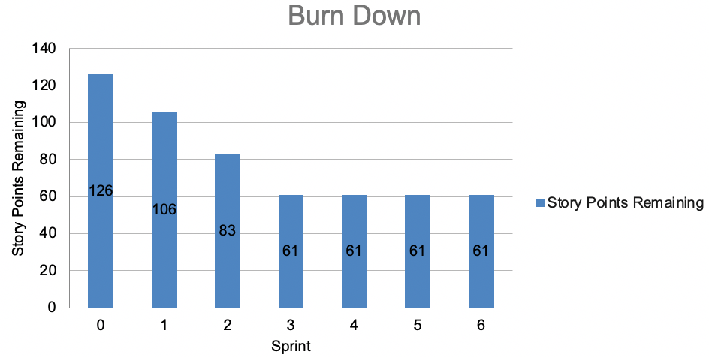
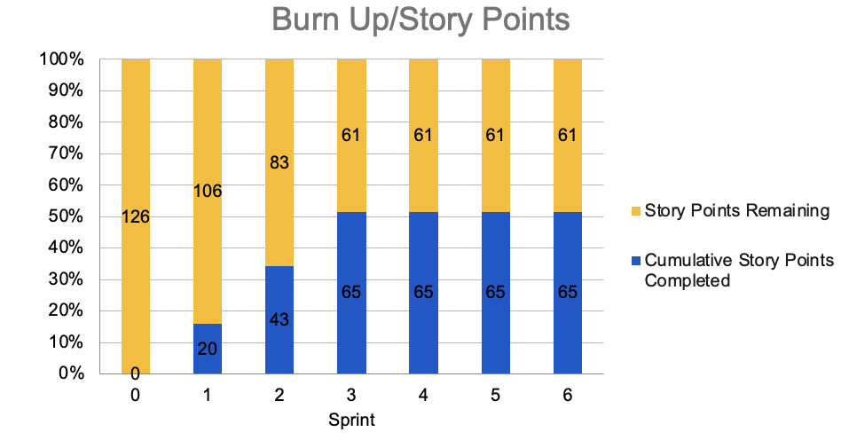
Sprints 1-3 Questions
What is your Velocity for the past 3 sprints?
[22]
How do you know your Velocity is correct?
[（20+23+22）/ 3 = 22]
What would the BURN DOWN chart look like for Sprints 1-3?
[Place your chart to the right]
What would the BURN UP charts look like for Sprints 1-3?
[Place your chart to the right]
How many points do you think the Team should commit to for Sprint 4 and justify your answer?
[around 22, the velocity is supposed to be a stable number]

Slide 4
Agile Communication
Project
Sprint 4

Slide 5
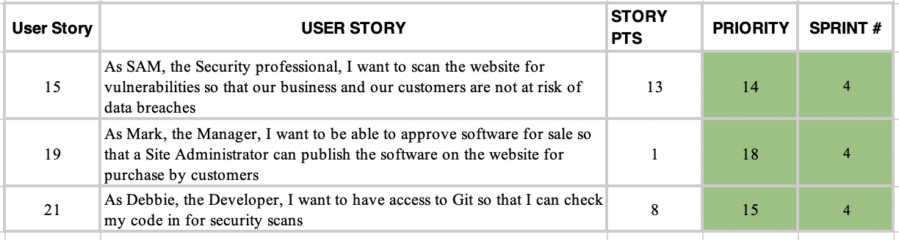
User Stories Table for Sprint 4

Slide 6
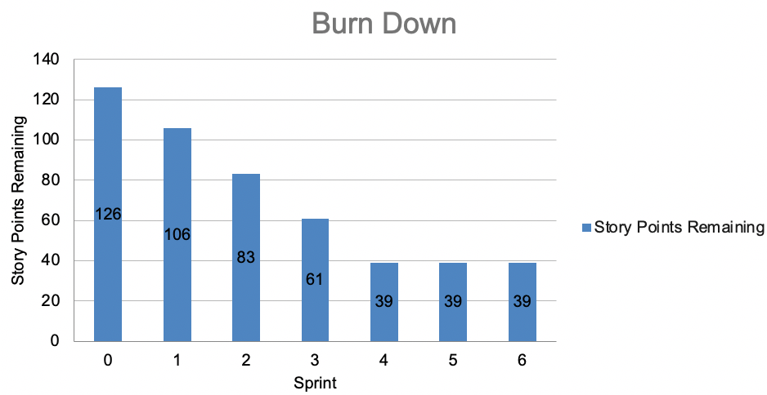
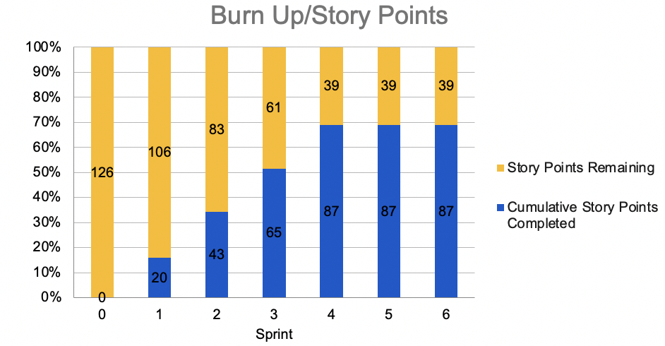
Sprint 4 Questions
What would the BURN DOWN chart look like for Sprints 1-4?
[Place your chart to the left]
What would the BURN UP charts look like for Sprints 1-4?
[Place your chart to the left]
How did the re-prioritization impact the Sprint 4 schedule?
[Due to the prevelant of cyper attacks, the team focused on system security and code security. The major tasks were stories 15 and 21.]
What Theme or Name did you give to Sprint 4?
[Firewall]

Slide 7
Never Step Back
Sprint 4 Name
“Firewall“
User Stories in Sprint 4
1. Story # 15 with 13 points
2. Story # 21 with 8 points
3. Story # 19 with 1 points
vulnerabilities
Total Sprint 4 Points: 22
Narrative -1. Sam, the security professional, will find and fix the website vulnerabilities to reduce the potential risks; 2. Debbie, the developer, will make sure the codes are robost without vulnerability.
Results – 1. Find out and fix website vulnerabilities Learnings – 1.System security is always in the top priority; 2. Making sure the system can publish products
Risks – System vulnerabilities can potentially cause customer and property loss.
SPRINT 4 DEMO of Working Product

Slide 8
Agile Communication
Project
Sprint 5

Slide 9
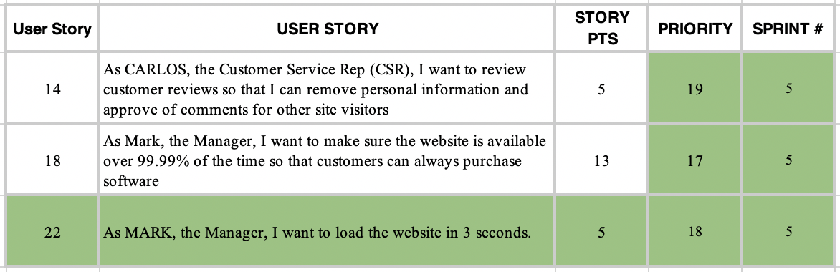
User Stories Table for Sprint 5

Slide 10
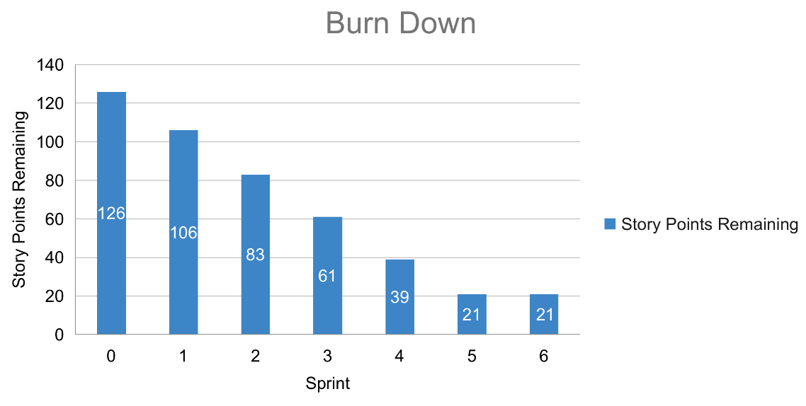
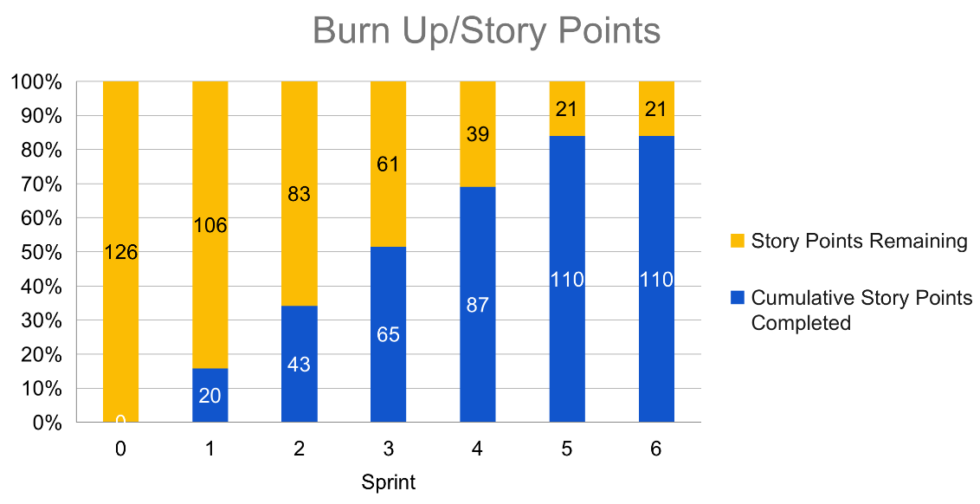
Sprint 5 Questions
What would the BURN DOWN chart look like for Sprints 1-5?
[Place your chart to the left]
What would the BURN UP charts look like for Sprints 1-5?
[Place your chart to the left]
How did the re-prioritization impact the Sprint 5 schedule?
[After receiving the feedback from user interview, the priority is to fix the issues found and improve user experience.]
How confident are you in delivering all of the user stories by the end of Sprint 6? Justify your answer.
[I think we can diliver it on time. There are 23 points remain, and our efficiency is 23 points.]

Slide 11
Never Step Back
Sprint 5 Name
“UX Improvement“
Place Sprint 5 Burn UP Chart Here
User Stories in Sprint 5 1. Story # 18 with 13 points
2. Story # 22 with 5 points 3. Story # 14 with 5 points
Total Sprint 5 Points: 23
Narrative – Listening to users, and increasing customer satisfaction with better UX. Results – suggestions from user interview will be followed to improve the UX, but one extra requirement would be moved to the next Sprint.
Learnings – Internal review can help to find out the flaws before user interviews. Team could have more contact with users in development process to avoid too much unexpected requirements from user interviews.
Risks – losing clients.
SPRINT 5 DEMO of Working Product

Slide 12
Agile Communication
Project
Sprint 6

Slide 13
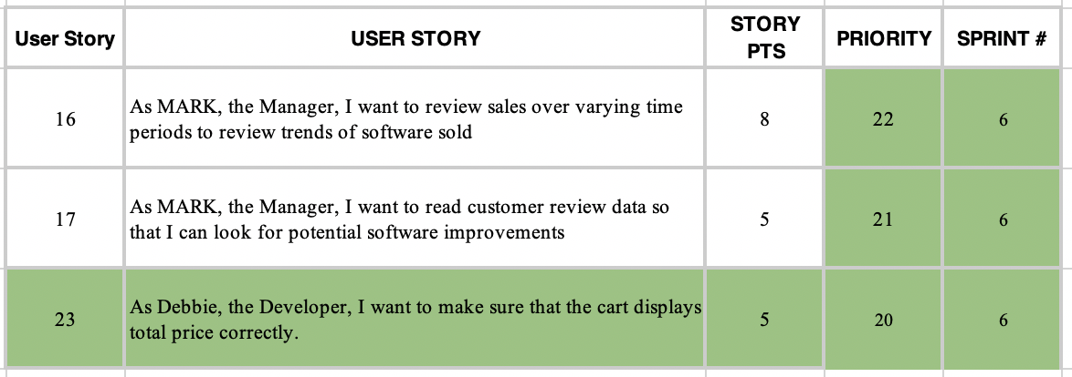
User Stories Table for Sprint 6

Slide 14
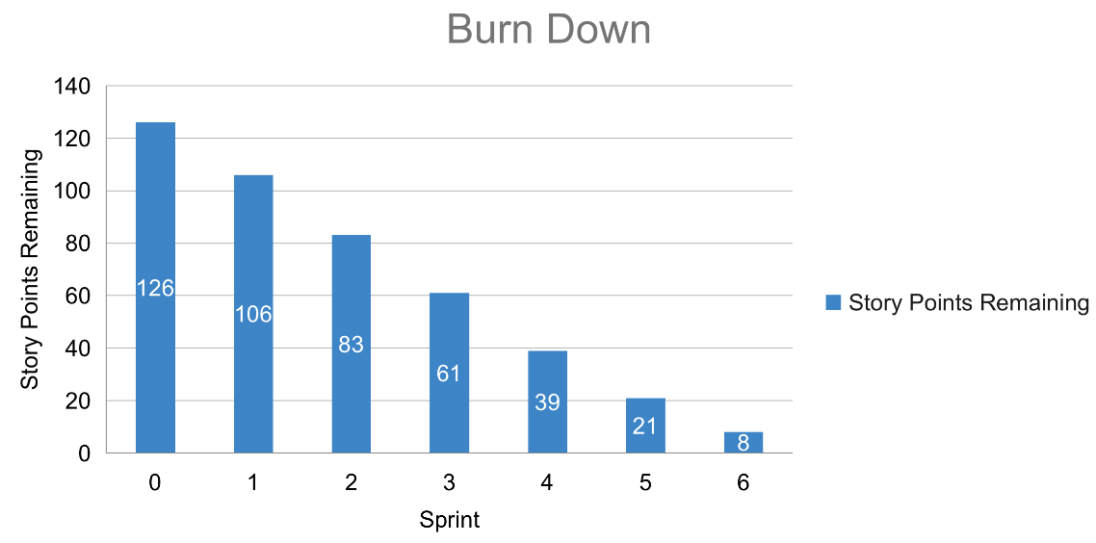
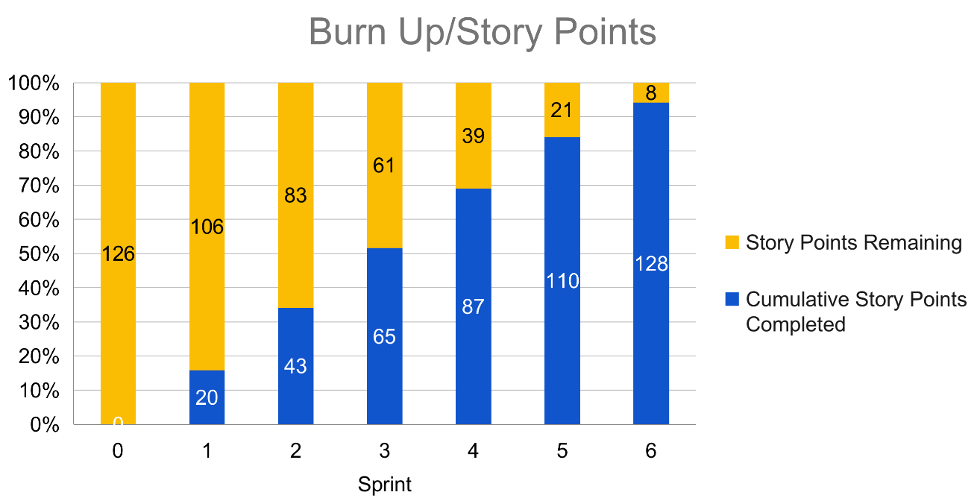
What would the BURN DOWN chart look like for Sprints 1-6?
[Place your chart to the left]
What would the BURN UP charts look like for Sprints 1-6?
[Place your chart to the left]
Was the Team able to complete all the work in the backlog or did you have to adjust what could be delivered? How would you tell this to Management and justify your answer.
[No, we could not. Due to the prevelant of cyber attack and to meet the requirements collected from the user interview, the story points increased unexpectedly. The team could not ideally deal with the external changes.]

Slide 15
Never Step Back
Sprint 6 Name
“Quick Response“
Place Sprint 6 Burn UP Chart Here
User Stories in Sprint 6
1. Story # 23 with 5 points
2. Story # 17 with 5 points
3. Story # 16 with 8 points
Total Sprint 6 Points: 18
Narrative - Team launches a BOGO promotion as a quick response to the global pandemic to save the profits.
Results - The quick response mitigate the impact caused by the pandemic. The code quality improvement was postponed to the next Sprint.
Learnings - always make quick response to the fast-changing market
Risks - The strategy may change in response to the pandemic.
SPRINT 6 DEMO of Working Product

Slide 16
BVIR for Management Questions
Which charts would you want to include in the BVIR that Management would need and why?
Move the Orange boxes to the correct column below
[I use burn down charts and burn up charts here. We use burn down charts to track the progress in the sprints, and the burn up chart focus on the iterations. Burn up charts will also show the increment of new works. Teams use Committed Vs. Delivered Chart to track the number of story points that they have committed to and compare them against the number of story points they have delivered.]
Included
Not included
Burn Down Charts
Story Point Cost per Team
Burn Up Charts
Committed vs. Delivered Chart

Slide 17
Creating the BVIR for Management
Questions to answer before you start the BVIR
What would tell Management if they want to know the details about actual stories?
[Select from the choices below]
"While I understand that you want to get into individual stories and know all the details, we would prefer that Management spends your valuable time guiding and influencing the Roadmap and direction of the project and leave the story delivery to the Teams you have empowered."
Absolutely, let's get into the details!
No, that is none of your business
Which of the above did you choose (1,2,3) and why?
[1 - The Roadmap and direction of the project were correct. The delay of the delivery was caused mainly because of the environment (cyber attacks, user feedbacks and pandemics), so I think we can seek guides from Management of how to cope with those external changes in the future. Usually, Management does not have right to be aware of the individual stories (all the details).]

Slide 18
Creating the BVIR for Management
Questions to answer before you start the BVIR
Is it project considered a failure because backlog items still remain? Explain.
[No, most items were completed and the items remined can be moved to next Sprint. The only postponed user story is about improving code quality, but the functions of the program are complete. There was not any fatal issues of the project, and the team did well in responding to the external factors, including cyber attacks, user feedbacks and pandemics. From the Sprints, we can see that most story points were met. From the Burn down charts, we can see that the team did overall a great job. Therefore, this project is not a failure.]

Slide 19
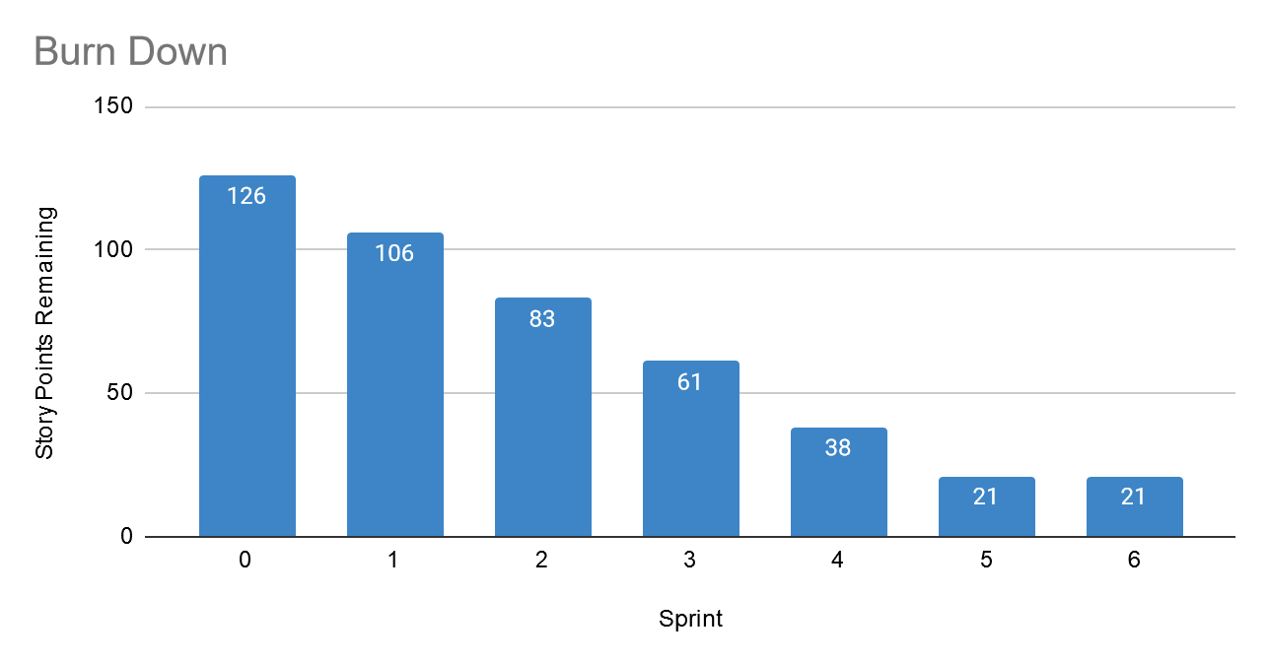
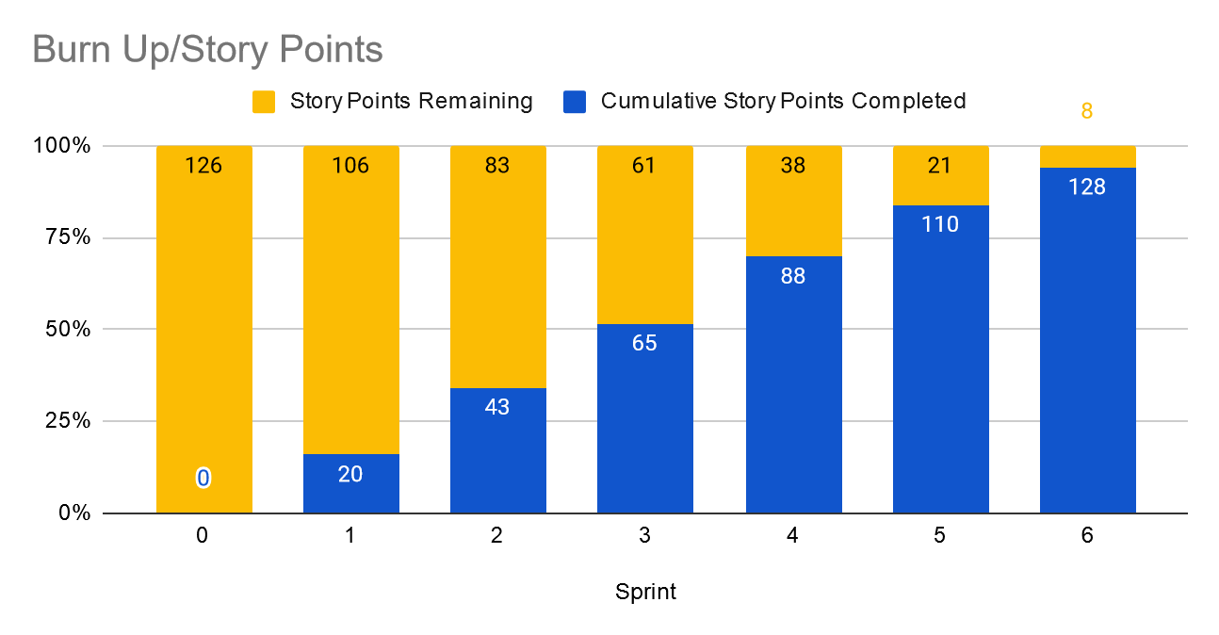
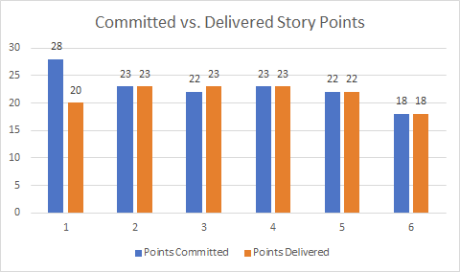
Creating the BVIR for Management
Instructions:
Start by creating your own BVIR. From the charts and sections below, please drag and drop items you would like to display to convey the story behind the MVP project
[Cut and paste items from this section and add them to the next slide. Remember to fill in information in the boxes where it is needed]
Roadmap
MVP VISION
Never Step Back
Chart Comparing Sprint Velocity of Teams 1 vs Team 2
Chart showing cost per story point

Slide 20
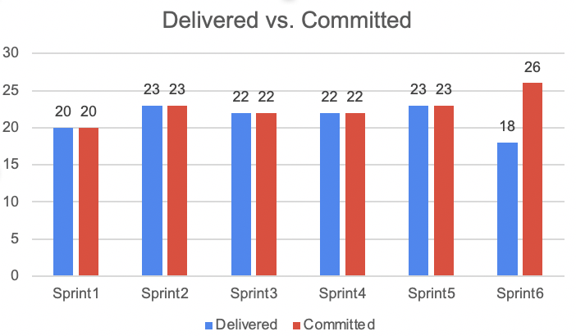
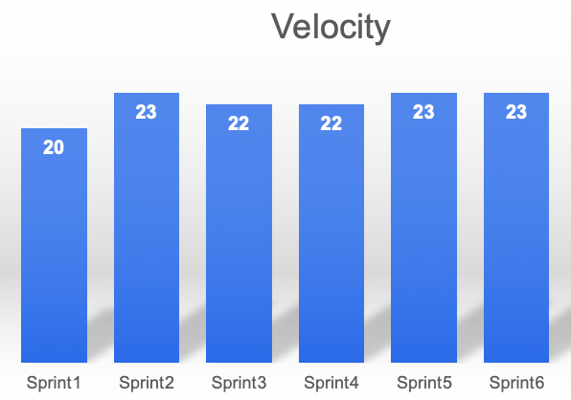
BVIR for Management
MVP VISION
We are building a world class e-commerce platform aiming at provide the world-class online shopping experience.

Slide 21
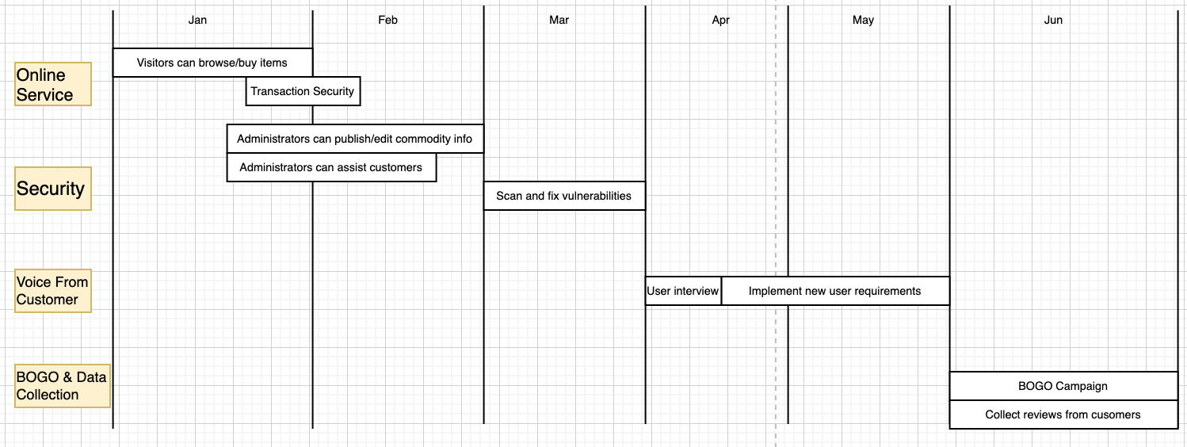
BVIR for Management
- Roadmap

Slide 22
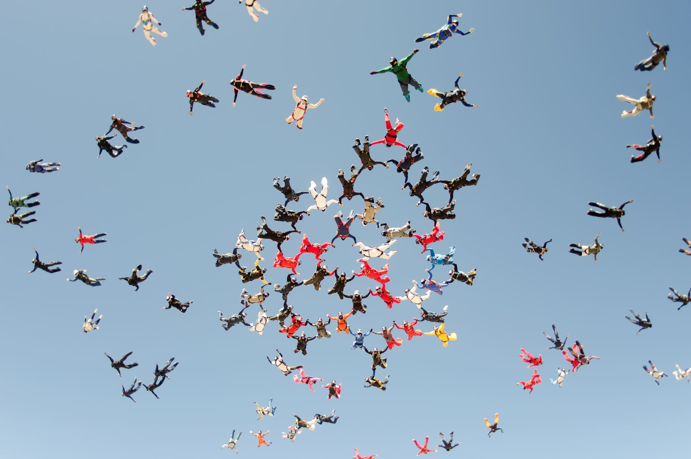
BVIR for Management
[Now that you have created your BVIR for management, you need to create a video or written narrative explaining the MVP delivery status.
Use this slide to write your narrative or plan what you want to say in your video. ]
Include (at the minimum) the following:
1.Team Name Never Step Back
2.Vision We are building a world class e-commerce platform aiming at provide the world-class online shopping experience.
3.Sprint Burn Down Charts for Sprints 1-6 Already displayed
4.Sprint Burn Up Charts for Sprints 1-6 Already displayed
5.Project status (complete / incomplete) not completed, 5 story points remain.

Slide 23
Questions from Management (Using Videos would be great!)
Instructions:
Watch the videos in the classroom.
Record your videos or provide your answers below. Remember to justify your answer.
[Video # 1 Answer] Hi Ms. CFO, iteration one of the core principles of agile. We accept imperfect product, and we will continuously improve the website. Besides, the main functions were done, and the user feedback was great. It is safe to release it. [Video # 2 Answer] Hi Ms. CMO, we made quick response to the environment. As you may know, the many software companies have encountered cyber attacks. If we had not examined and fixed the vulnerabilities and stuck to the plan, we might loss more. [Video # 3 Answer] Hi Mr.CEO, working for 24/7 could solve the problem for now, but it is not a healthy working style. In the agile development, we want to maintain a constant pace indefinitely, and we don't want to burn them out. [Video # 4 Answer] Yes sure, let's complete this project.

